Slide 2


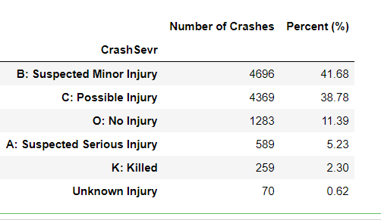
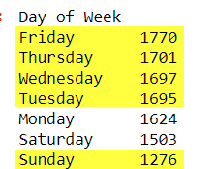
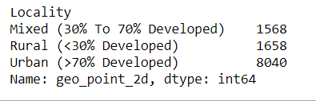
Total crashes: 11266
Number of Counties : 100
Number of Cities: 327
Only 7% involved intoxicated Bikers
14.74% were Hit-n-Run cases
Least crashes on Sundays (due to low traffic?)
Other days are almost equal
71% were in urban areas

Slide 3
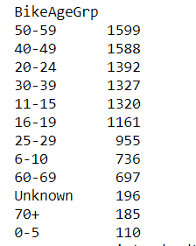
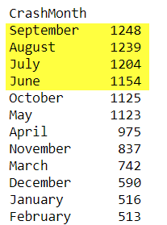
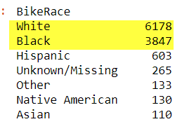
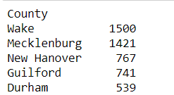
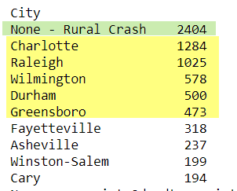

Most crashes happen in Summer Months (Jun-Sep)
More than half are white bikers (54.83%)
Age grouping
Top 5 Counties with most crashes
About 1/5th crashes are from rural areas
Top 5 cities with most crashes are:
Gender grouping

Slide 4
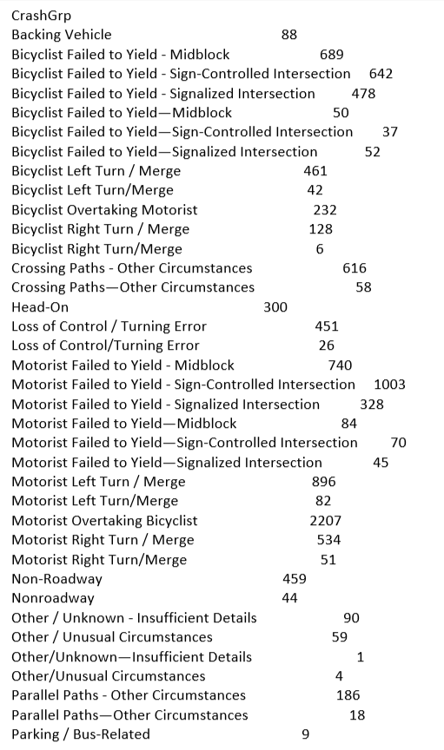

Slide 5
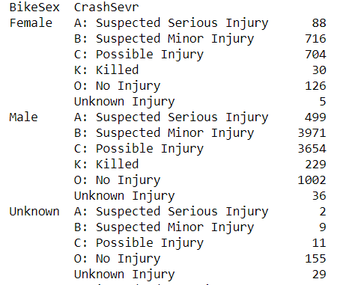
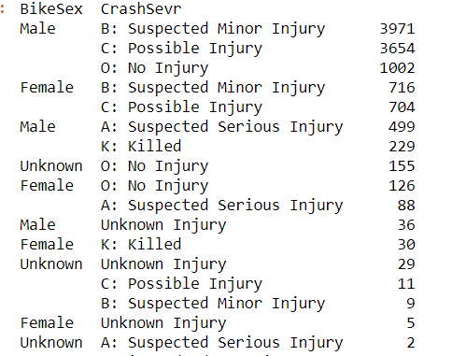
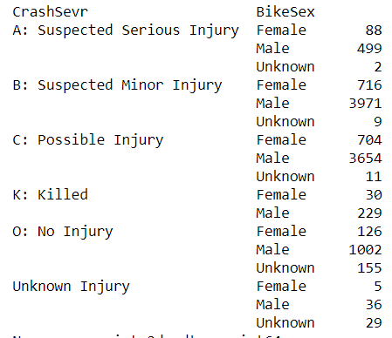
Crash Severity Vs. Gender – multiple views
Sorted
Sorted

Slide 6
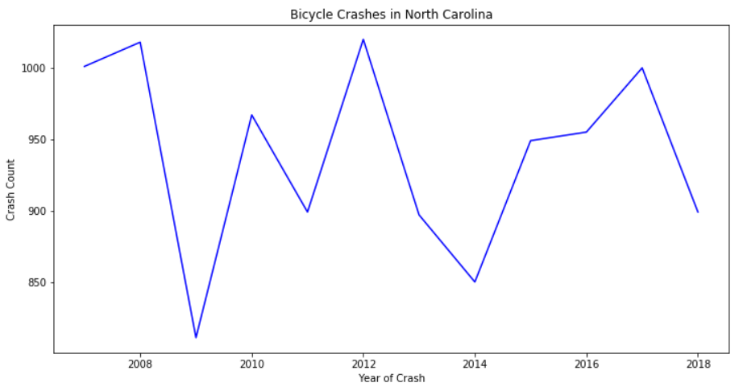
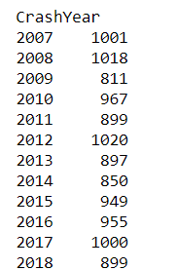
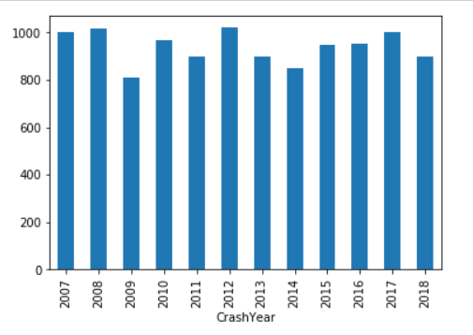
Total crashes: 11266
Number of Counties : 100
Number of Cities: 327
There is no drastic change in crash counts from 2007

Slide 7
